Slide 1
Fast Facts: Recognizing Tardive Dyskinesia
This piece was sponsored and co-developed by Neurocrine Biosciences. The faculty have been compensated by Neurocrine Biosciences. This piece is intended to provide general information about tardive dyskinesia and not medical advice for any particular patient.

Slide 2
What Types of Movements Are Consistent With TD?
Recognizing Tardive Dyskinesia
TD can affect any part of the body, and movements can appear¹:
  Choreiform
  Rapid, jerky, nonrepetitive
  Let’s take a look!
  Athetoid
  Slow, sinuous, continual
  Semirhythmic
  Repetitive, purposeless²; also called “stereotypy”
  Distinctly different from the rhythmic tremor commonly seen in drug-induced parkinsonism
TD, tardive dyskinesia.
1. American Psychiatric Association. Diagnostic and Statistical Manual of Mental Disorders. 5th ed., text rev. American Psychiatric Association; 2022. 2. Hauser RA, et al. CNS Spectr. Published online November 20, 2020.

Slide 3
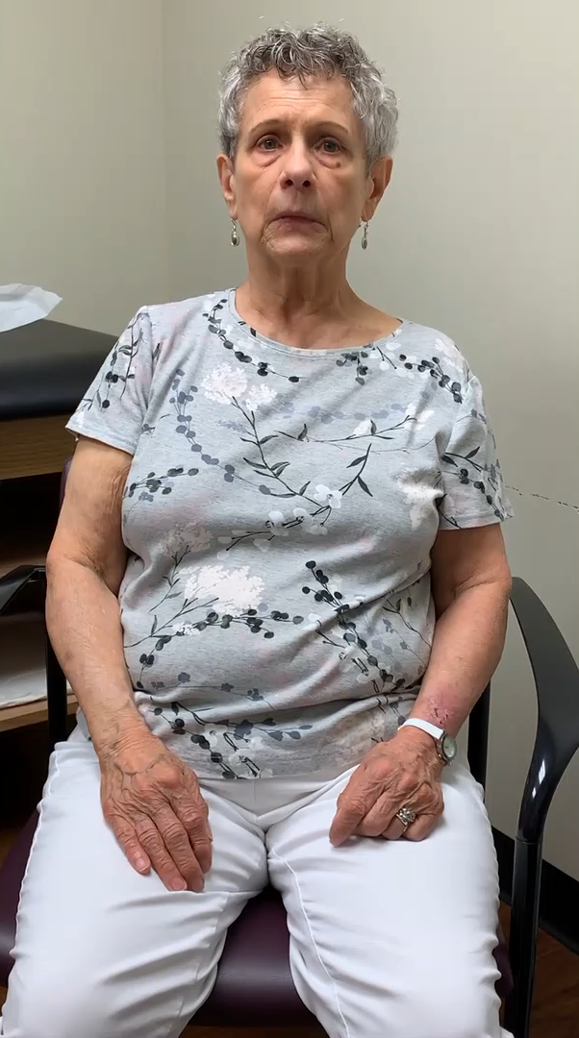
Orofacial Movements
Recognizing Tardive Dyskinesia
Orofacial movements are one of the most obvious and common manifestations of TD, though other body regions may be affected and should not be neglected¹
Orofacial movements may include:
Bulging of the cheeks²
Chewing or sucking³
Grimacing or frowning³
Tongue protrusion³
Tongue pressing against cheek³
Lip puckering or smacking⁴
Lateral jaw movement or jaw protrusion³
This patient has consented to the use of this video.
Patient with TD manifesting as moderate orofacial movements, including lip licking, sucking movements, and tongue rolling and darting
1. American Psychiatric Association. Diagnostic and Statistical Manual of Mental Disorders. 5th ed., text rev. American Psychiatric Association; 2022. 2. Tarsy D. Curr Treat Options Neurol. 2000;2(3):205-214.
3. Owens D. BJ Psych Adv. 2018. 25(1),57-69. 4. Hauser RA, et al. CNS Spectr. 2022;27(2):208-217.

Slide 4
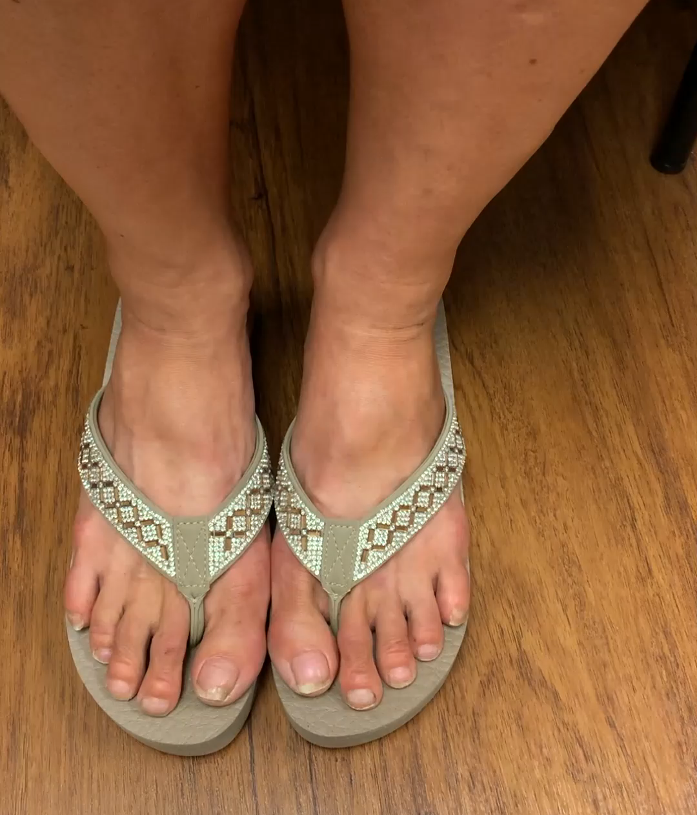
Look Beyond the Face: TD Can Affect the Trunk and Limbs^{1,2}
Recognizing Tardive Dyskinesia
What to look for:
Limbs^{1,2}
Trunk²
Typically distal, repetitive
movements¹
Sustained cervical or
axial postures
“Piano-playing” fingers²
Shoulder shrugging
Foot tapping and sustained
toe postures²
Rocking and swaying
Rotatory or thrusting
hip movements
  Trunk and limb movements associated with TD
  can interfere with ambulation in some patients³
This patient has consented to the use of this video.
Patient with TD manifesting as toe-tapping movements
1. Savitt D, Jankovic J. J Neurol Sci. 2018;389:35-42. 2. Tarsy D. Curr Treat Options Neurol. 2000;2(3):205-214. 3. Hauser RA, et al. CNS Spectr. 2020: 27(2):208-217.

Slide 5
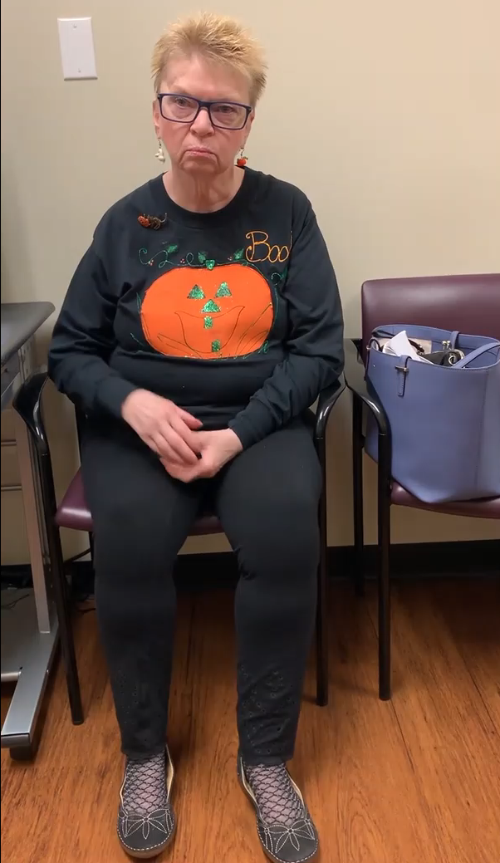
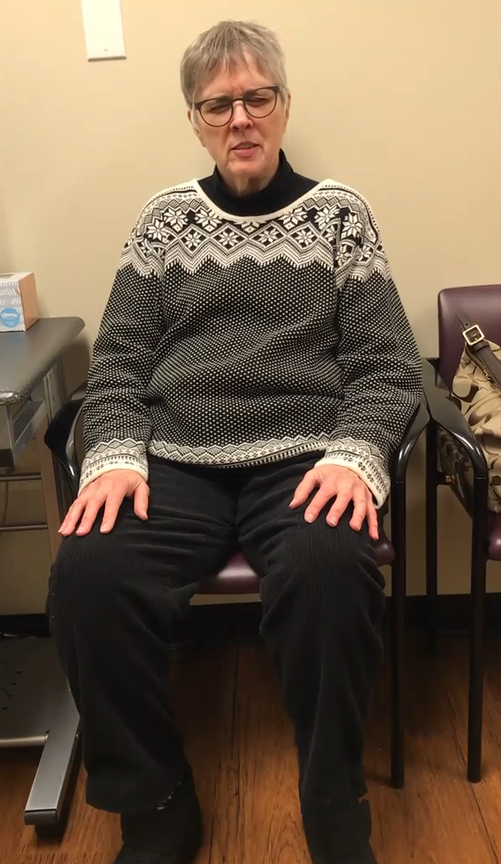

TD Can Present With a Range of Severities, and Mild Movements Should Not Be Overlooked
Recognizing Tardive Dyskinesia
Mild
Moderate
Severe
This patient has consented to the use of this video.
This patient has consented to the use of this video.
This patient has consented to the use of this video.
Primary TD symptoms: Mild orofacial
movements (primarily lip pursing),
hand clasping, and foot fidgeting
Primary TD symptoms: Moderate
chewing/sucking movements,
blepharospasm, and dystonic facies
Primary TD symptoms: Moderate-to-severe
truncal rocking, nodding, toe tapping,
tooth grinding, and lip curling/pursing
The impact of TD can be multifaceted (eg, social, emotional, functional) and should not be determined based solely on movement severity¹
1. Jackson R, et al. Assessment of the Impact of Tardive Dyskinesia in Clinical Practice: Consensus Panel Recommendations. Neuropsychiatr Dis Treat. 2021;17:1589-1597.

Slide 6
Ask yourself:
Does it look like TD?

